Slide 1
Leadership Training – “Radical Candor(彻底的坦诚)”
The Surprising Secret to Being a Good Boss
Tom Tsao
May 2016

Slide 2
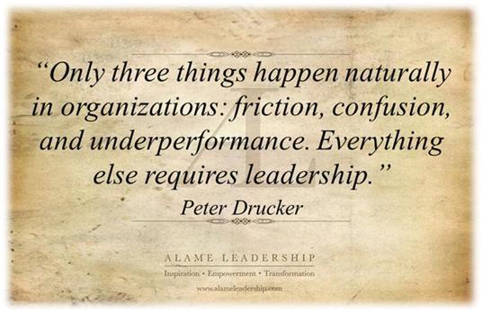
Why Management / Leadership Training?

Slide 3
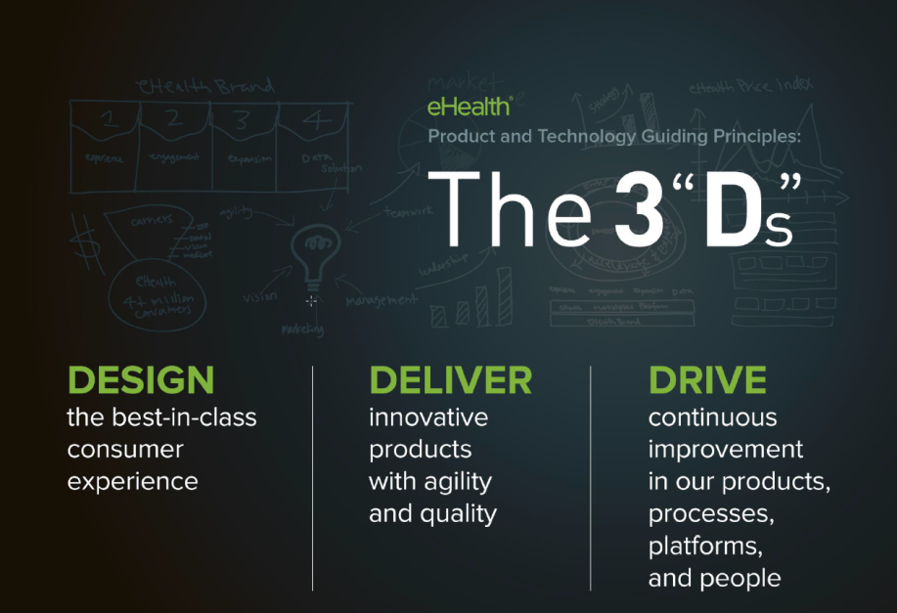

Slide 4
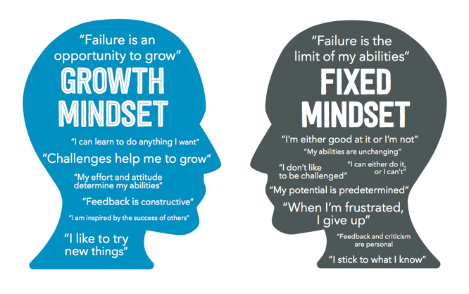
Continuous Improvement = Growth Mindset
Managers need to coach their teams to adopt a Growth Mindset
Notes:
http://big-change.org/growth-mindset/
http://trainugly.com/mindset-makers-breakers-pt1/

Slide 5
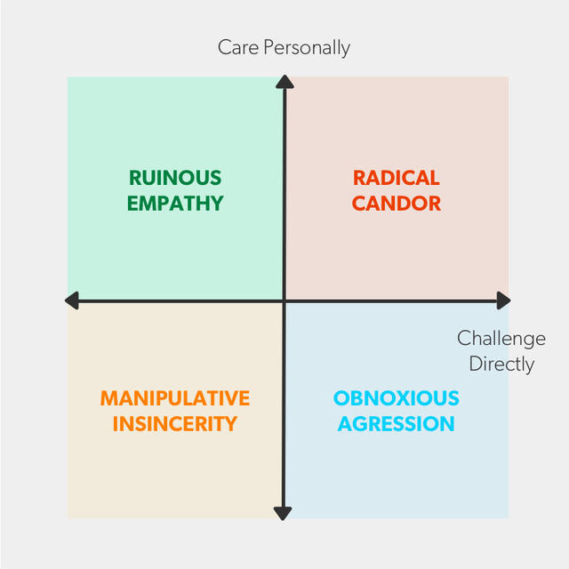
破坏性的同情心
彻底的坦诚
操纵的伪善
可憎的侵犯

Slide 6
Radical Candor Article – Group Discussion
http://firstround.com/review/radical-candor-the-surprising-secret-to-being-a-good-boss/
Please share 1-2 key learnings or insights from reading the article
Do you agree that radical candor is the best way to manage (or be managed)? Why or why not?
Do you commonly experience radical candor from your managers or team members? Why or why not?
Are there any cultural barriers to living out radical candor in Xiamen? If yes, how can you/we overcome them?
What immediate steps can you take to start to live out radical candor in your key working relationships?
破坏性的同情心
彻底的坦诚
操纵的伪善
可憎的侵犯

Slide 7
Scenario Role Play
There is a software upgrade project which will impact many cross-functional teams.
We need to upgrade the software because we will no longer receive support on the current version.
The PO for this project has set-up a kick-off meeting with leads from various cross-functional teams.
On the day of the kick-off, multiple leads do not show up and did not let the PO know ahead of time that they would not show up.
Key Players:
  PO of the project
  Team Lead that did not show up
  People Manager for the team lead
➔ What would you do as PO for the project? What do you do as the People Manager for the project?

Slide 8
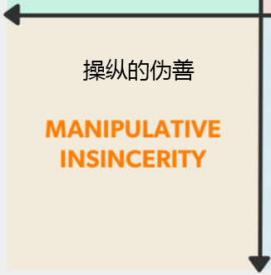
Role Play #1
People Manager and PO discuss and agree Team Lead should either have attended the meeting or sent a decline out of courtesy/respect.
Instead of saying anything to the Team Lead, they decide to talk to others about the situation.

Slide 9
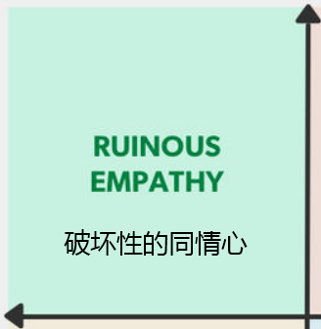
Role Play #2
People Manager does not agree with feedback from PO and becomes defensive.
People Manager says nothing to the Team Lead about the incident and tells the Team Lead they are doing a great job.

Slide 10
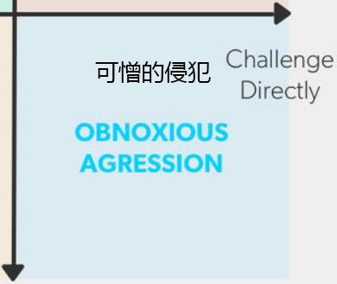
Role Play #3
People Manager actively listens to PO and will take action.
People Manager says something to the team lead, but in a non-constructive way.

Slide 11
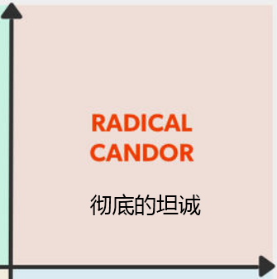
Role Play #4
People Manager actively listens to PO and will take action.
People Manager says something to the team lead in a constructive way and provides context/reason why it’s important to attend meetings or decline.

Slide 12
What do you do as Team Lead?
Team Lead receives the feedback by actively listening and makes a change.
Team Lead receives the feedback, takes it personally and is unhappy with the PO and takes it out on the PO (retaliation)

Slide 13
Constructive Feedback Training

Slide 14
Growth Mindset Requires Constructive Feedback
Managers need to coach their teams to adopt a Growth Mindset
Notes:
http://big-change.org/growth-mindset/
http://trainugly.com/mindset-makers-breakers-pt1/

Slide 15
Too Nice =
No Feedback
Constructive
Feedback
破坏性的同情心
彻底的坦诚
操纵的伪善
可憎的侵犯
Insincere
Feedback
(say one thing to your face, and another thing behind your back)
Mean
Feedback

Slide 16
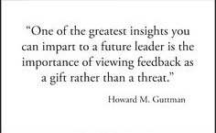
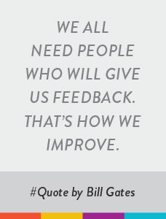
Feedback is a Gift…That’s How We Improve
Notes:
Group Discussion: Gather experiences / chart learnings/

Slide 17
Who Should Give & Receive Constructive Feedback?
Manager to Direct Report
Peer to Peer
Direct Report to Manager
Basically, everyone who wants to continuously improve and make things better at eHealth
Notes:
Rena to note there is no right answer but rather an opinion. Will either take notes online or maybe better chart answers on a flip chart

Slide 18
How to Deliver Constructive Feedback
Constructive feedback is a gift when done well
Constructive feedback is letting people know in a helpful way how they are doing
Let someone know what they are doing well and what they
could or need to do differently or better
Feedback should not be vague, generalized, mean, or exaggerated
Constructive feedback is delivered with specific examples in a kind, friendly, and actionable way so it’s easy to listen to and act on
I recommend using the “When You…I Feel” framework
Notes:
“Turn around success” is a person who after coaching improved and is considered successful and accomplished employee
In Closing perhaps return to the first Exercise to see if any thing would change in their response …. Which is easier to coach … Ability or Motivation?

Slide 19
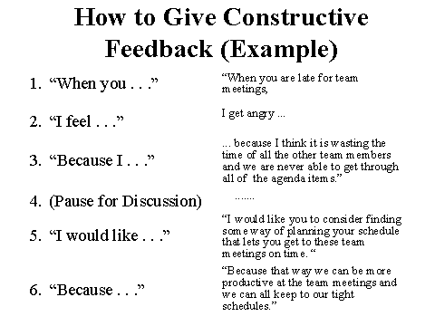
“When You…I Feel” Framework
Notes:
Group Discussion: Gather experiences / chart learnings/

Slide 20
“When you…I feel…” – Role Play Exercise
Pair up with someone next to you and take turns role playing something “live” for you but keep it anonymous.
How should we handle “retaliation(报复)”?

Slide 21
Feedback Training from Mike Tadlock

Slide 22
Remember…Feedback is a Gift!
Constructive feedback is a gift when done well
Constructive feedback is letting people know in a helpful way how they are doing
Let someone know what they are doing well and what they
could or need to do differently or better
Feedback should not be vague, generalized, mean, or exaggerated
Constructive feedback is delivered with specific examples in a kind, friendly, and actionable way so it’s easy to listen to and act on
I recommend using the “When You…I Feel” framework
Notes:
“Turn around success” is a person who after coaching improved and is considered successful and accomplished employee
In Closing perhaps return to the first Exercise to see if any thing would change in their response …. Which is easier to coach … Ability or Motivation?

Slide 23
Too Nice =
No Feedback
Constructive
Feedback
破坏性的同情心
彻底的坦诚
操纵的伪善
可憎的侵犯
Insincere
Feedback
(say one thing to your face, and another thing behind your back)
Mean
Feedback

Slide 24
Conflict Resolution Training

Slide 25

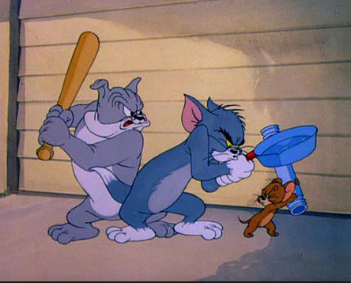
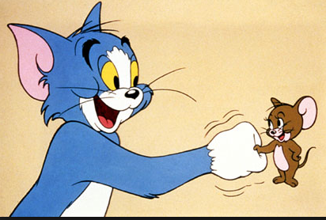
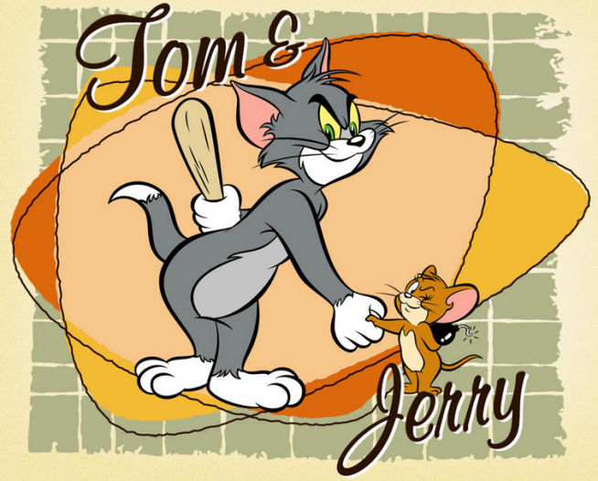
What’s the Best Way to Resolve Conflict?
Peace
Breaker
Maker
Faker

Slide 26
Peace Faker
Peace Maker
破坏性的同情心
彻底的坦诚
操纵的伪善
可憎的侵犯
Peace Faker
Peace Breaker

Slide 27

1. Express your need
Start with assumption that your teammates deserve the benefit of the doubt
Treat them with respect
Deal with it directly (1:1)

Slide 28

2. See if the need can be met
Focus on intended result/business outcome
Explain your context and why you need it
Seek to understand the context of your teammate

Slide 29
3. If not, negotiate or manage conflict
Don’t take things personally
Consider how you may contributing to the situation
Set clear behavioral norms – (ground rules, team working agreements) and get to a win/win scenario
Be a peace maker, not peace faker or breaker
When all else fails, escalate and get help

Slide 30
Examples of Conflict – Role Play Exercises
Someone consistently does not show up to meetings on time or at all without communication ahead of time
Someone consistently misses their deadlines without providing transparency or advance warning
Someone doesn’t speak up when there’s a question, problem, or disagreement with the rest of team
    More detailed user stories
    More clarity on roadmap
    Communicating trade-offs or puts & takes when hard dates impact the current backlog

Slide 31
Summary – Be a Peace Maker
Avoidance or unresolved conflict results in dysfunctional teams and relationships
Be a peace maker, not peace faker or breaker
3 steps to be a peace maker:
    Express your need respectfully
    See if the need can be met
    If need cannot be met, negotiate or manage conflict to a win/win

Slide 32
Summary

Slide 33
Continuous Improvement = Growth Mindset
Managers need to coach their teams to adopt a Growth Mindset
Notes:
http://big-change.org/growth-mindset/
http://trainugly.com/mindset-makers-breakers-pt1/

Slide 34
破坏性的同情心
彻底的坦诚
操纵的伪善
可憎的侵犯

Slide 35
Too Nice =
No Feedback
Constructive
Feedback
破坏性的同情心
彻底的坦诚
操纵的伪善
可憎的侵犯
Insincere
Feedback
(say one thing to your face, and another thing behind your back)
Mean
Feedback

Slide 36
Peace Faker
Peace Maker
破坏性的同情心
彻底的坦诚
操纵的伪善
可憎的侵犯
Peace Faker
Peace Breaker

Slide 37
Your Leadership is Key to eHealth’s Success!

Slide 38
Appendix

Slide 39
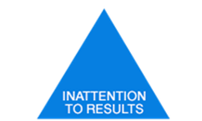




5 Dysfunctions of a Team
Dysfunction #5 – Inattention to Results
Status and Ego
Dysfunction #4 - Avoidance of Accountability
Low standards
Dysfunction #3 – Lack of Commitment
Leads to ambiguity
Dysfunction #2 – Fear of Conflict
Artificial Harmony
Dysfunction #1 – Absence of Trust
The fear of being vulnerable with team members

